Slide 1



Chatbot For ML Apps
Capstone Project
FINAL REVIEW
10th December 2022
Group-22

Slide 2

faculty mentor, Sponsors & team members – group#22
Faculty Mentor: Sumanta Singh
Assistant Professor of Information Systems, ISB
Client Mentor: Vineet Srivastava
Zero Code Learning
Sponsor: Sriram M
Zero Code Learning
12110019 - Mahesh G
9+ years in Banking & E-Commerce Analytics, Analytics Lead at Amazon
12110013 – Niharika Miriyala
3 years in Finance, worked as Senior Audit Associate at Deloitte
12110071 – Sidhartha Reddy
15 years in HR Strategy & Analytics,
Dr Reddy’s
12110052 – Varshini Modulla
4 years in IT, Software Engineer at Wells Fargo

Slide 3

AGENDA
BUSINESS UNDERSTANDING
TESTING &
MODEL EVALUATION
PROJECT
PROJECT SCOPE &
SUCCESS CRITERIA
ARCHITECTURE &
DESIGN APPROCHES
LITERATURE REVIEW
DATA COLLECTION &
PRE-PROCESSING

Slide 4
Business understanding
About The Company
Problem Statement
About The Platform
Zero Code Learning is a leading Edu-Tech Startup in the data science space. Zero Code provides ML Apps, a No-Code development platform, to help users focus on learning business challenges and outcomes instead of getting into the nuisance of coding Machine Learning models.
Users often need help with app usage. They reach out to the support team through emails and often, there is a delay in assistance either because of different time zones or the support team are swamped with multiple issues.
Zero Code Learning provides platform where users (Academicians & Students) can easily user ML models. Platform is simple and has easy to navigate buttons and tabs to explore the models, parameters and data insights. Users can train the model using their own data set and make predictions without coding.

Slide 5
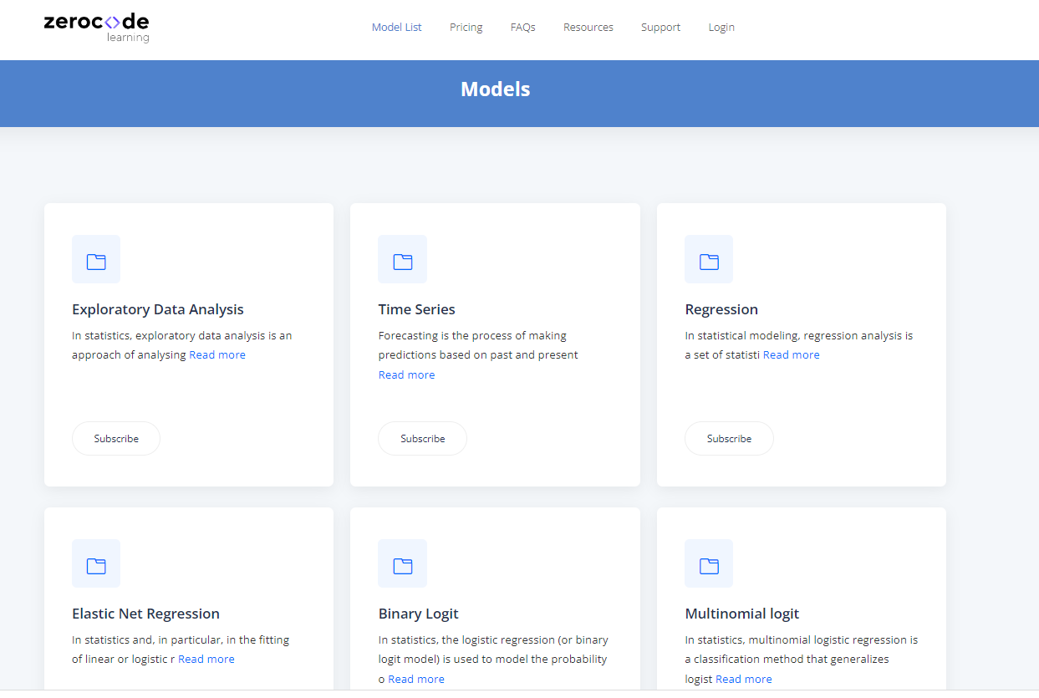
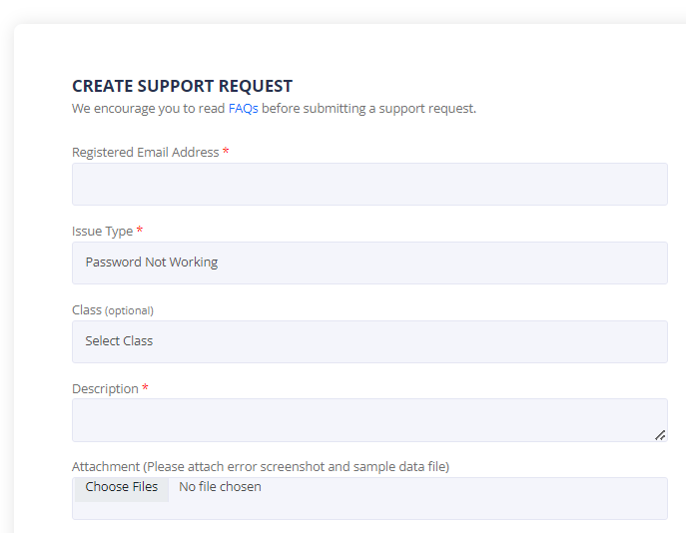

Business understanding
Zero Code Learning Platform
Support Systems

Slide 6
Current Working Model
MLApps PLATFORM
M1
M2
M3
2
User has query?
Student
1
M4
M5
No
M6
Academician
--
--
--
M28
M29
M30
Yes
4
3
response to user
Users email/raise ticket to Support Team
High level Workflow
User tries an ML model in MLApps platform
MLApps returns model results
If any query, user emails Support team
Support team responds to user query
Challenges
With ever increasing users/subscribers, email mode of query resolution is highly inefficient
The learning experience is negatively impacted with delayed query resolution

Slide 7
Project Scope & Success Criteria
Project Requirement
Build a Chatbot that will provide a faster response to user queries and scale to handle multiple users at the same time. This will improve customer service and overall business for the company.
Scope & Deliverables
Working POC of the Chatbot using ML/DL and NLP techniques
Initial accuracy of 30%-40% as suggested by the Sponsor
Bot which is trainable for further enhancements
Source code, documentation and data files
80% of queries to be immediately answered by the chatbot
Minimize the time spent by the customer service team
Business Success Criteria
Provide immediate assistance to the users
Scale as needed to accommodate multiple users at the same time
Economic Success Criteria
ML Success Criteria
Accuracy of more than 30%
Response time of < 30 sec
Success Criteria

Slide 8
assumptions
Assumptions about the model
Users will use Chatbot only to pose questions on tool usage and basic theoretical questions on the models
Though we initially have minimal data, the database will be periodically updated by the support team to create a huge corpus
The user queries will be in English language only
The user will ask only one question at a time
Assumptions about Deployment & Maintenance
The support team will maintain the list of questions that are routed to them and will periodically update the context file
Users rating captured after the response will be periodically analyzed and low rating questions will be addressed by updating the context file

Slide 9
LITERATURE REVIEW
We reviewed papers across journals like IEEE, Springer, JMLR etc.,
The following publications helped us to design the solution approach
Title | Use case | Design Approach | Dataset | Metrics
BERT: Pre-training of Deep Bidirectional Transformers for Language Understanding | Multiple NLU and NLG tasks | BERT is finetuned for NLP tasks like paraphrasing, question answering, text classification, sequence tagging. Also explains feature extraction-based approach with Bert | SQuAD, SWAG | GLUE score, MultiNLI accuracy and F1 score
Question and Answering Using BERT | Reader is given certain paragraphs to read and answer some questions related to those paragraphs | Bert model with the embedding layer at the top, encoder layer and end layer with Linear layer. In output layer, SoftMax generates the predicted probability of start & end position of the answer | SQuAD | None
End-to-End Open Domain Question Answering with BERTserini | Integrate BERT with the open-source Anserini IR toolkit to create BERT-serini, an end-to-end open-domain question answering (QA) system | BERTserini is comprised of two modules: Retriever is responsible for selecting segments of text that contain the answer, which is then passed to the reader to identify an answer span | SQuAD | Exact match(EM), F1 score, Recall(R)
Chatbot: A Conversational Agent employed with Named Entity Recognition Model using Artificial Neural Network | Chatbot for Cab Booking | Intent Classification - BOW + multi-class NN NER - NER Spacy + multi-class NN | Manually prepared dataset with 4 columns - query, response, intent and entities. CoNLL-2003 dataset for validation | Intent Classification - Precision, Recall, F1-score NER - Confusion matrix and classification report
Notes:
Add intent classification

Slide 10
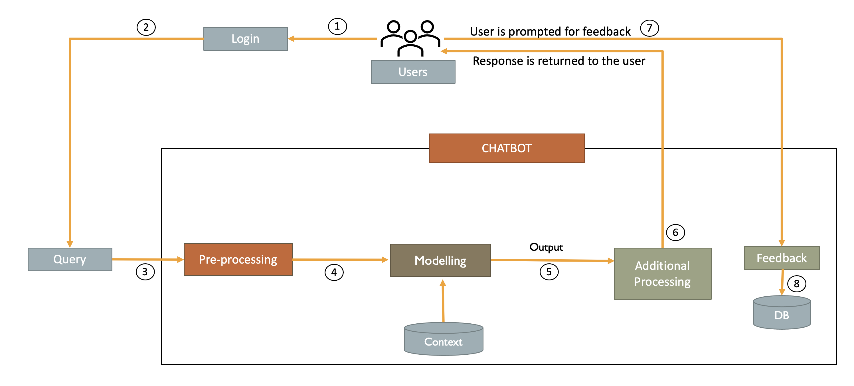
SOLUTION OVERVIEW

Slide 11
Modelling
Intent Classification
Question Answering Baseline Model
Question Answering Pipeline Model
Dynamic Selection of Model
Notes:
Mahesh- add smart art

Slide 12
Modelling
Intent Classification
Question Answering Baseline Model
Question Answering Pipeline Model
Dynamic Selection of Model
Notes:
Mahesh- add smart art

Slide 13
Data preprocessing
Data Collection
Data Format
{‘intents’: [
{‘tag’: 'tool_usage’,
‘patterns’: ['where can I set the number of clusters?’, ‘how to set the number of clusters’],
‘responses’:[‘The 'Left panel' has the option of 'Choose the number of clusters. By default, the number is set to '3' and can be changed as per requirement ‘]
},
{‘tag’: ’conceptual’,
‘patterns’:[‘what is data winsorizing?’, ‘explain winsorization’],
‘responses’:[‘Winsorizing or winsorization is the transformation of statistics by limiting extreme values in the statistical data to reduce the effect of possibly spurious outliers’]
}
}
Sponsor shared the information of login related queries that is presently received on the platform
We built a database of sample user queries from following
User manuals
FAQs
Experienced the platform to understand the possible user queries
We prepared a dataset of 120 questions for 5 models and paraphrased them to 350 questions.
Data Pre-Processing
Tokenization
Convert to Lower case
Punctuation removal

Slide 14
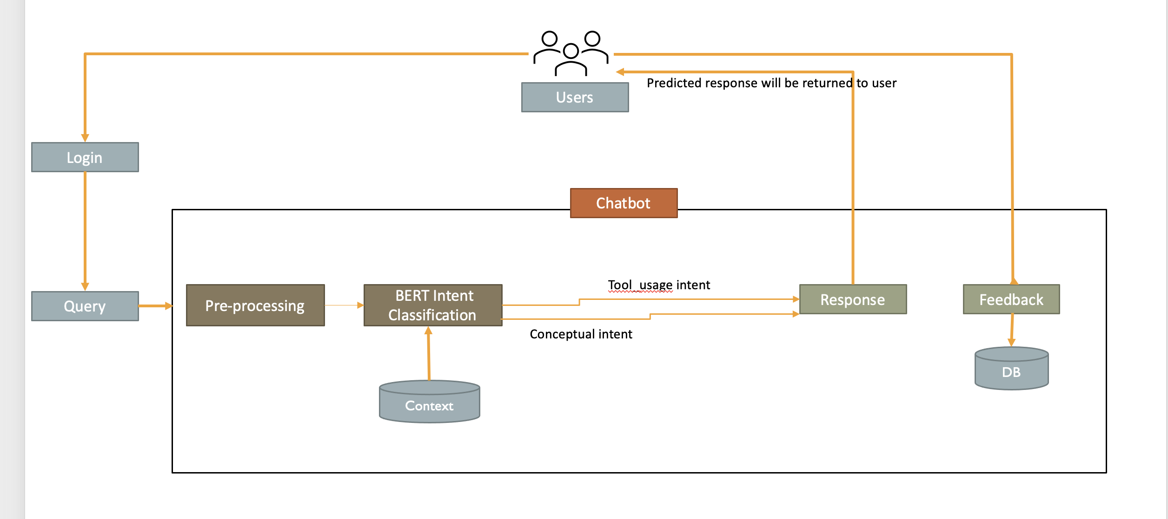
Intent Classification

Slide 15
disadvantages
The number of incorrect answers was very high
No domain-specific Q&A pairs dataset out there
Could not improve accuracy than 15%
Creation and maintenance of json data files is tedious

Slide 16
Modelling
Intent Classification
Question Answering Baseline Model
Question Answering Pipeline Model
Dynamic Selection of Model
Notes:
Mahesh- add smart art

Slide 17


DATA COLLECTION, PREPARATION AND PREPROCESSING
Data Collection
The sponsor shared the information on login-related queries and User manuals of the models that contain the tool usage & conceptually related information
We built a database of two textual documents:
- A textual document containing the common functionality of all models
- A textual document containing model-specific functionalities
The information from the manuals is paraphrased to the extent necessary for the model to retrieve accurate responses to the queries that the chatbot is posed
Data Pre-Processing
Tokenization
Convert to Lower case
Punctuation removal

Slide 18
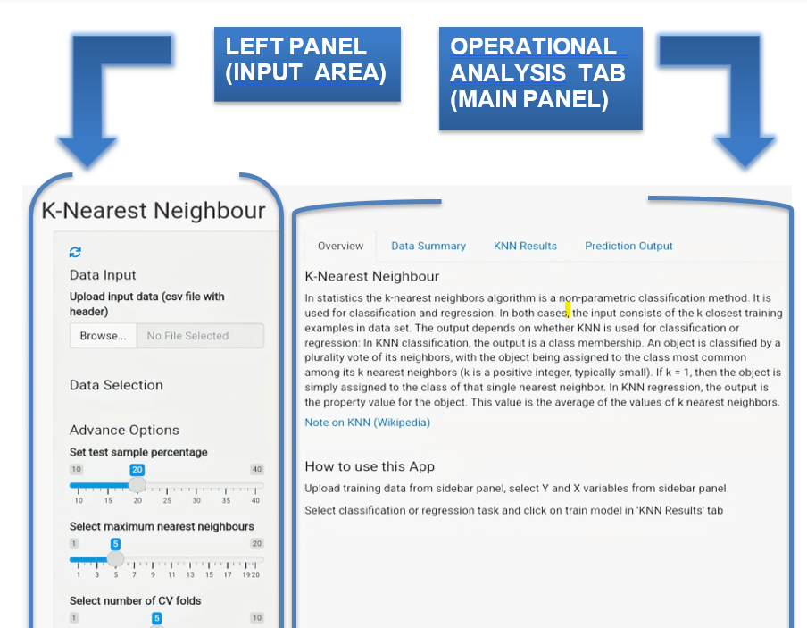
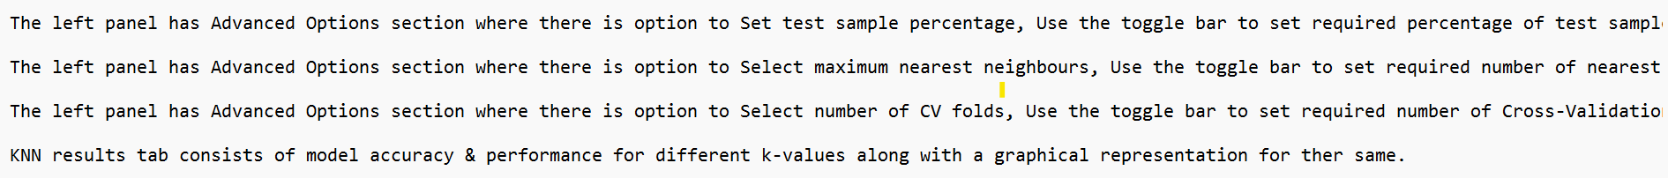
Data preprocessing
User Manual information
Processed Text (referred as Context file)
Notes:
Niharika –add report screen shot

Slide 19

Model-I: BERT QA+ PATTERN MATCHING
Query
2
Login
1
8
Users
3
CHATBOT
Pattern Matching
Modelling
Multiple Sentences Matched
Apply Sentence Similarity
7
Pre-processing
Hugging Face BERT Question Answering Model
Model Output
Return Matched Sentence
Single Sentence Matched
Response
4
5
6
No sentence matched
Return QA Model Output
Feedback
9
Context
DB

Slide 20
Sample workflow
Reference text:
The Main panel has PCA visualization tab which shows 2D visualization of clusters.
The Main panel consists of a Tab called Cluster Analysis which has a graph showing optimal number of clusters by dotted line.
List of sentences returned after pattern matching:
[' the main panel has pca visualization tab which shows 2d visualization of clusters.’,
'the main panel consists of a tab called cluster analysis which has a graph showing optimal number of clusters by dotted line.']
Sentence Similarity Scores:

Slide 21
DISADVANTAGES OF baseline MODEL
The sanctity of the reference text is lost when it is tokenized
The Pattern Matching module increases latency as it must go through all the reference text to match a sentence. As the reference text increases, so does the response time
Pattern Matching is leading to information loss, reducing the accuracy of the model

Slide 22
Modelling
Intent Classification
Question Answering Baseline Model
Question Answering Pipeline Model
Dynamic Selection of Model
Notes:
Mahesh- add smart art

Slide 23
Model-2: BERT QA PIPELINE
Query
2
Login
1
8
Users
3
CHATBOT
Modelling
Sentence Retriever
Start and End tokens of Output
Retrieve the complete sentence based on the start and end tokens of the model output
7
Pre-processing
Hugging Face BERT Question Answering Pipeline
Response
Feedback
4
5
6
9
DB
Context

Slide 24
Sample workflow
Sentence Retrieval
.Regression analysis is a way of mathematically sorting out which of those variables does indeed have an impact.
2471
2549

Slide 25
Advantages of PIPELINE MODEL
The Hugging Face pipelines have additional post-processing to enhance the model’s output
The pipeline returns the start and end tokens of the answer, preserving the sanctity of the text, and allowing us to extract the complete sentence
Accuracy increases as there is no information loss caused by pattern matching
Probability score returned by the pipeline can be used to analyze the confidence of the answer given by chatbot

Slide 26
Modelling
Intent Classification
Question Answering Baseline Model
Question Answering Pipeline Model
Dynamic Selection of Model
Notes:
Mahesh- add smart art

Slide 27
Model-3: Dynamic model selection
Query
2
Login
1
8
Users
3
CHATBOT
Pre-processing
Modelling
Sentence Retriever
Hugging Face BERT Question Answering Pipeline
Start and End tokens of Output
Retrieve the complete sentence using the start and end tokens of the model output
Dynamic Selection
4
Return the sentence which has highest Cosine similarity with the question
7
5
6
Response
Modelling
Pattern Matching
Pattern Match the sentences which have the model output and return the most similar sentence
Hugging Face BERT Question Answering Model
Model Output
Feedback
5
Context
9
DB

Slide 28
Sample workflow
Sentence Similarity using Cosine Distance:
Similarity for Baseline Model: 0.63
Similarity for Pipeline Model: 0.04

Slide 29
Advantages of DYNAMIC SELECTION
The few questions which are incorrectly answered by Model-2 are correctly answered by Model-1
Combining them both with a layer of Dynamic Selection increases the accuracy of the chatbot
The Dynamic Selection module calculates sentence cosine similarity between the answers given by each model and the question and returns the answer which matches the most
TRADEOFF: As accuracy increases, response time also increases

Slide 30
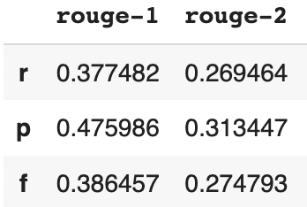

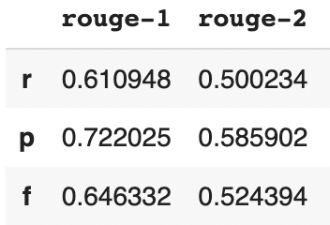
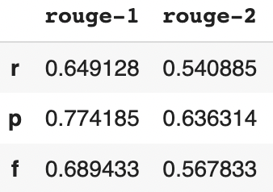
Testing approach
55 questions were prepared from the manuals of various models that were used for context/reference
These questions were passed to both models.
To get the best-of-both responses, Cosine similarity has been used
1
Baseline model
Dynamic model selection
Test Question | Correct response
Q1 | A1
Q2 | A2
Q3 | A3
…… | …..
Q55 | A55
Cosine similarity
Response with highest score
User feedback
Context / reference file
2
Pipeline model
**Hugging Face pipeline model also gives the probability for each response. This is another metric for assessing model response.

Slide 31
Why dynamic selection of model?
Both models’ responses to the test questions were manually checked and tagged as “Correct” and “Incorrect”.
2x2 matrix of both the model’s performance is below:
Dynamic model performance:
In isolation, the Baseline model is accurately responding to 45% of questions (26 / 57)
The pipeline model is accurately responding to 75% of questions (43 / 57).
By dynamic selection, we are getting the best of both models. 91% (52 / 57) of questions were accurately responded to.
Pipeline model
 | Correct answer | Incorrect answer
Correct answer | 17 | 9
Incorrect answer | 26 | 5
26 correct responses
Baseline model
Tradeoff between Accuracy & Response time:
This accuracy improvement is coming at the expense of response time.
Average Response time is going up from ~8 seconds to ~33 seconds
43 correct responses

Slide 32
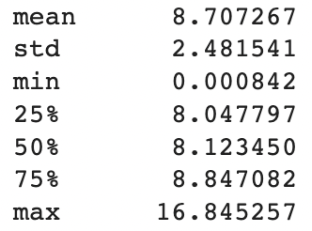
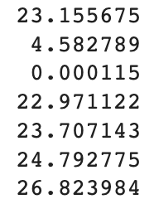
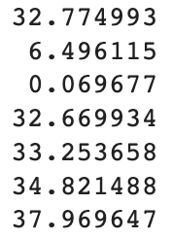
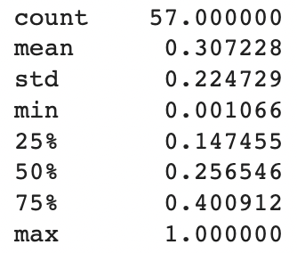
Metrics & Evaluation
ROUGE-1
Response time *
Probability
This score measures the number of matching unigram (‘1-gram’) between our model predicted answer and the 'reference’.
Mean time taken by the model for giving a response to user
Below are the probabilities for the test queries as returned by Hugging face pipeline model.
Baseline
Pipeline
Hybrid
 | Recall | Precision | F1 Score
Model 1 | 0.37 | 0.47 | 0.38
Model 2 | 0.61 | 0.72 | 0.64
Hybrid | 0.64 | 0.77 | 0.68
* On personal laptop
Extracting most relevant text as response to user query
ROUGE compares the model generated text with the human-generated reference text.
Hybrid / Dynamic model improves both ROUGE-1 and ROUGE-2 scores
More accuracy comes at the expense of higher response time
75% of the queries are responded within 8.8 seconds within baseline model.
Pipeline model resolve 75% queries within ~23 seconds and Hybrid model within ~33 seconds
Response probability
This is applicable to Pipeline model only, which is answering majority queries
On an average, Pipeline model is responding with 0.25 probability of correct response
Any response below 0.15 probability could be relooked
Reference link on ROUGE:
https://towardsdatascience.com/the-ultimate-performance-metric-in-nlp-111df6c64460

Slide 33
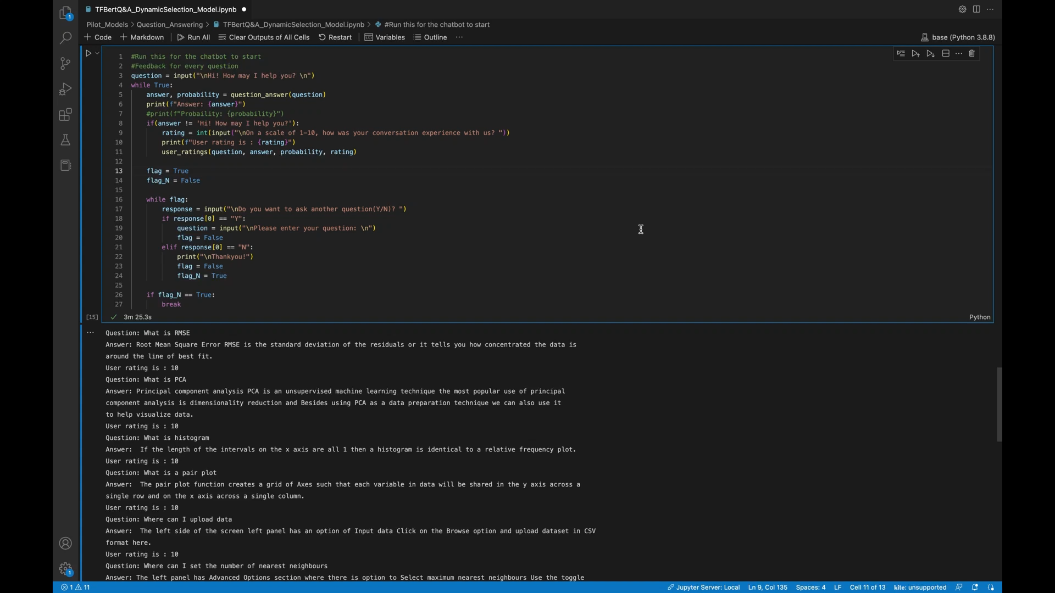

Slide 34
Maintenance & Scalability of the model
Model design:
The model is designed to scale up for multiple models.
As long as the input text file is drafted cleanly and passed, the model will provide responses
Input files:
The context/reference source for the model is the text file (.txt) in which manual contents are maintained in the form of simple sentences.
For any new model addition or standard user query, the simple text needs to be appended.
Text maintenance:
While BERT extracts only relevant phrases from the context, to make it more readable for the user, the model is built to extract the complete sentence containing the relevant phrase.
The model identifies sentence start and end by locating full stops.
It is therefore very important to keep the sentences crisp, and relevant when appending new text. Sentences must end with a full stop.

Slide 35
CONTINUOUS IMPROVEMENT WITH USER feedback
Helps in Monitoring
Which questions are not correctly answered by the Chatbot
Which answers need to be elaborated to help the user
Which questions the model is unable to find answers to and update the context
Helps to perform additional Analytics
Most used model
Functionality needing the highest assistance
Identify model and data drift

Slide 36



















Technical Stack and Tools Used
Data Acquisition
Data Sources
Data Pre-processing
Data Modelling
Model Evaluation
Model manuals from Zero Code Learning
.txt files created based on the tool usage
.txt files created based on the concepts
Q&A pairs with intent

Slide 37

Challenges
No Real-time Dataset with user queries
No domain-specific Q&A pairs available
Convert user manuals to txt files
Retrieve complete sentence from the phrase output
Prepare own data for testing

Slide 38

Way Forward
Extend to new model related data
Add speech and language translate options
Build a Cache layer for frequent user queries to improve response time
Extend current Chatbot to a Guided Chatbot
Can extend to other Apps of ZeroCodeLearning
Enhance existing MLApps tool basis the frequent user queries
Generate insights from the user queries and feedback

Slide 39



Deliverables
Solution Design & Architecture
Code and Developer’s Manual
Model evaluation metrics and results
Final Model
Project Report

Slide 40

Progress against the project plan
Task | Start Date | End Date | Progress
Requirements, Scope and Deliverables finalization | 5th Sept, 2022 | 23rd Sept, 2022
Data Collection and Preparation | 24th Sept, 2022 | 10th Oct, 2022 | Prepared textual files from five model user manuals
Literature Review | 24th Sept, 2022 | 7th Oct, 2022 | Reviewed multiple publications and selected the design approach Attended workshop on Building Intelligent Chatbot with ML and DL
Modelling | 8th Oct, 2022 | 13th Nov, 2022 | Finalized the Design Approach Explored Intent Classifier Bert base model Explored Intent Classifier LSTMs with Siamese Architecture Explored RASA framework for conversational chatbot Explored pre-trained TFBertForQuestionAnswering Finalized and modelled 3 Question Answering models
Testing | 14th Nov, 2022 | 20th Nov, 2022 | Tested the 3 Question Answering models and captured ROUGE score and response time metrics
Presentation to Sponsor | 21st Nov, 2022 | 27th Nov, 2022 | Presentation, demo and code-walk through to the sponsor
Final project Report | 27th Nov, 2022 | 3rd Dec, 2022 | Complete and submit final review presentation and report
Project Handover, code & documentation | 4th Dec, 2022 | 9th Dec, 2022 | Complete Project handover and submit code & documentation to the sponsor

Slide 41
THANKYOU

